Slide 1


REVIEWING RECEPTION MEASURES FOR THE INTEGRATION
OF LEGAL IMMIGRANTS IN THE EUROPEAN UNION
‘Professional integration of migrants in Italy’
Paris, 18th April 2013
Francesca Biondi Dal Monte
General Directorate for Immigration and Integration Policies
Unit IV - “Unaccompanied Minors and Integration Policies”

Slide 2
Summary
The institutional framework
Pre-departure Training Programmes
Bilateral Agreements
The measures in Italy. The website on integration
Training and qualification. RE.LA.R. project
Development of integrated system of Human Services. ASSAP project.
Integration and access to work for unaccompanied minors
Social and labour integration of young migrants
Immigrants’ enterprises. Start it up project
Professional integration of migrant women

Slide 3
1. The institutional framework
Ministry of Interior Ministry of Labour and Social Policies
Collaboration in the determining of migration inflows in Italy
The main reason for entry into Italy is employment (more than 50% of entries)
Permits for work relate to subordinate work, self-employment and seasonal work.
Migrants are required to have a job before their arrival in Italy
Economic crisis – increased unemployment – many migrants lost their job within a
year of their arrival in Italy

Slide 4
1. The institutional framework
Territorial councils for immigration established within the “Prefetture”
- locally monitor the presence of foreigners on the territory as well as the capacity to absorb the migration flows;
promoting initiatives and making proposals through a close cooperation between the institutions.
Single Desk for Immigration has been set up in each “Prefettura”. It deals with issues relating to first recruitment of foreign workers and family reunification
Important role by regions, local authorities, third sector organizations, especially in the integration of migrants and social services

Slide 5
2. Pre-departure Training Programmes
Subjects: The programmes are organized by regions, provinces, municipalities, national organizations of employers, trade unions, associations and other entities with at least 3 years of experience in the area of immigration and others.
National institutions involved: The projects are evaluated and authorized by the Ministry of Labour and Social Policies and the Ministry of Education.
Object: Providing educational activities and training in countries of origin.
Programmes that involve the employment of a significant number of trained migrants have priority funding.

Slide 6
2. Pre-departure Training Programmes
Objectives:
a) to provide targeted job placements in Italian productive sectors within Italy
b) to provide targeted job placements in Italian productive sectors within the countries of origin
c) to promote the development of productive activities and autonomous business in the countries of origin
Migrants involved in the programmes are recognized with reserved entrance quotas

Slide 7
3. Bilateral Agreements with Third Countries
Bilateral regulations in order to manage migration flows of third country nationals for employment reasons.
Objectives:
a) to strengthen international cooperation on migration issues with countries that strongly characterize migration flows to Italy;
b) to establish a partnership with these countries in order to better manage the entry of foreign workers, through the connection between institutions, ensuring security and transparency;
c) to improve the match between demand and supply of labour (e.g. selection of qualified foreign workers; vocational training programmes; share technical tools).
Stipulated agreements: Albania; Egypt; Morocco; Moldova; Sri Lanka; Republic of Mauritius.

Slide 8
4. The measures in Italy. The website on integration
www.integrazionemigranti.gov.it
Inter-institutional Project launched in January 2012
Co-financed by the European Fund for the Integration of non-EU immigrants
Goal To promote and support the integration process of migrants in Italy
1.200 stakeholders connected in a virtual network
850.000 visited web-pages

Slide 9
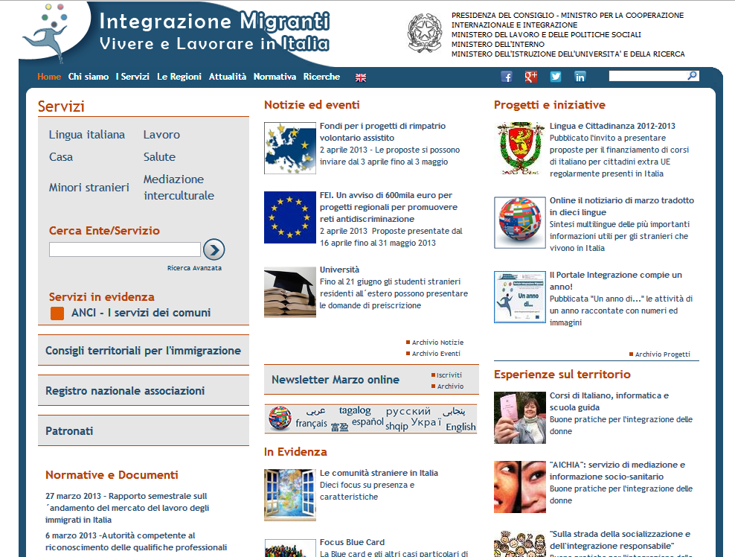
4. The web site on integration. Labour area
Areas of integration
National Plan for Integration
Forthcoming translation in ten languages
Other information useful for the integration path

Slide 10
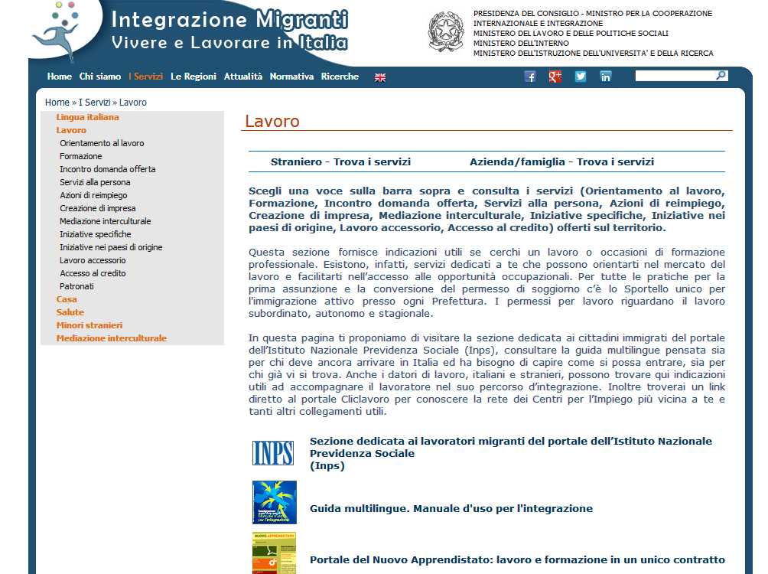
4. The web site on integration. Labour area
Sections in Labour Area (Supply-Demand Match, Professional Training, Personal Services, Re-employment, Access to Credit, Intercultural Mediation, etc.)
Diversified navigation paths for workers and employers.
Geo-referenced mapping of over 4,500 socio-working integration services

Slide 11
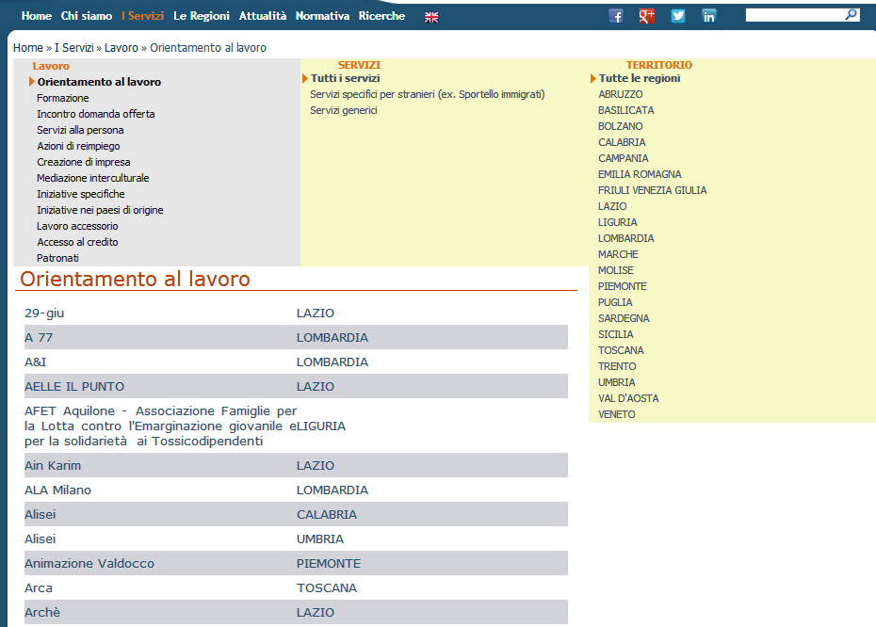
4. The web site on integration. Labour area
Example: work orientation
Type of services in this section
Services on the territory (Italian Regions)
List

Slide 12
5. Training and qualification. RE.LA.R project
Object: training and qualification of migrants through training paths (duration: from 3 to 5 months) and the subsequent conclusion of a contract of employment for the training participants (duration: not less than 6 months).
Training paths must provide language courses (with the issue of a certificate of knowledge) and a course on the health and safety conditions in workplaces.
The aim of the intervention is to encourage the implementation of measures and services in order to employ migrants (in particular holders of and applicants seeking international protection) in order to prevent and overcome the phenomena of exploitation, illegal work and social exclusion.

Slide 13
5. RE.LA.R project
Territories involved in the project: “Target regions” (Campania, Puglia, Calabria and Sicily)
Total resources: € 2,200,000.00 – Period: one year (2013)
Ministry of Labour and Social Policies and Italia Lavoro S.p.A
Collaboration between public administration and stakeholders, that presented specific project. Each project provided a grant for each participant for a maximum of € 5,000.00 divided into two parts:
frequency contribution for the participant
contribution for training paths, paid to the promoters of the projects. The contribution will be paid if the trainee is offered a job placement with contract of at least 6 months.

Slide 14
6. Development of integrated system of Human Services. ASSAP project
Health Care Services
The programme ASSAP is aimed at
1) improving the access to employment for migrants,
2) preventing unemployment,
3) overcoming the problem of undeclared work in the field of health care services.
Main measures: job-matching services; creation of networks between workers, training.
Territories involved in the project: The programme is realized in the “target regions” (Campania, Puglia, Calabria and Sicily).
Persons involved: about 5,000.00 migrants
Ministry of Labour and Social Policies and Italia Lavoro. Total resources: € 11,900,000.00

Slide 15
7. Integration and access to work for unaccompanied minors
The aim is to facilitate paths of social and professional integration for unaccompanied foreign minors in Italy, especially for children who will soon come of age.
Grants of € 3,000 (for training and skills qualifications) or € 5,000 (for access to the labour market) will be distributed to each beneficiary for active labour market policy services (vocational training, internship, etc.) and integration services through the elaboration of an individual intervention plan (Plan custom action - PIP). Grant distribution is implemented by municipalities or by third sector entities in collaboration with the responsible municipality.
Total resources: € 5,498,000.00
1,226 projects were funded
Collaboration with stakeholders and direct involvement of beneficiaries

Slide 16
8. Social and labour integration of young migrants
Social and labour integration of migrants, particularly regarding young migrants of working age from 17 to 30 years and migrants who are recipients of unemployment benefit (at least 150 people).
The aim of the intervention is to promote the creation and development of micro-enterprises.
The project involves the use of forms of guarantees in relation to loans in order to enable to start up businesses. A “guarantee fund” will be constituted through tenders addressed to all banking and financial operators.
Total resources: € 2,000,000.00

Slide 17
9. Migrants’ enterprises. Start It Up Project
The “Start it up” project was aimed at:
promoting the socio-economic integration in the Italian labour market of 400 migrants who wish to start a business through support in the elaboration of a business plan, in the access to microcredit or regional/local funds, etc.;
raising awareness thanks to 9 banks through the involvement of Chambers of Commerce, trade associations and local authorities with the aim to change the approach in assessing the creditworthiness of the credit system of immigrant businesses;
creating an inter-institutional network which can support social and economic integration of migrants (Chamber of Commerce, employment centres, municipal information desk, immigrant associations, trade unions, trade associations).
Total resources: € 800,000.00

Slide 18
9. Migrants’ enterprises. Start it up project
The projects involved 10 Chambers of Commerce and concerned the following Italian Regions: Lombardia, Piemonte, Friuli-Venezia Giulia, Veneto, Marche, Lazio and Puglia.
Chambers of Commerce encouraged and supported the creation of new businesses through the following services:
1) administrative simplification,
2) monitoring and dissemination of entrepreneurial culture (preparation of business plans, facilitating access to micro-credit, and competitive award of grants by the regions),
3) use of the instrument of micro-credit aimed at the start-up of micro-enterprises or self-employment.
Direct involvement of the beneficiaries (participants in the activities of awareness and training proposed by the project)

Slide 19
9. Migrants’ enterprises. Start it up project
Results:
Publication of the results of the project. Ten stories of start up enterprises
Mapping of migrant entrepreneurs
Final evaluation of the project impact during a meeting held in November 2012
Assessment of future policies based on the results of this project

Slide 20
10. Professional integration of migrant women
Proposal in the framework of the European Integration Fund in order to support the autonomy of vulnerable groups among migrants, especially unaccompanied foreign minors under transition to adulthood (16-17 years) and young female migrants at risk of social exclusion (until 24 years)
Specific objectives:
achievement of a good level of independence and integration into Italian society
Set of measures regarding: legal and administrative assistance; coaching and supporting
services; job placement; housing, cultural and recreational services.
Strengthening of the network of public institutions and private organizations supporting the
autonomy of vulnerable migrants, particularly of young women

Slide 21
Thank you for your attention
For further information please contact fbiondi@lavoro.gov.it
General Directorate for Immigration and Integration Policies
Unit IV - “Unaccompanied Minors and Integration Policies”

